Slide 1
SPIRA Care Plan
Blue Select Plus Network (EPO)

Slide 2
Plan & Network
Access to Spira Care Centers
Must live or work in one of 12 counties:
  Missouri: Clay, Jackson, Platte, Cass, Clinton, DeKalb, Johnson, Lafayette, Ray Caldwell
  Kansas: Johnson, Wyandotte
In-Network coverage only, except emergencies
Do not have to select a primary care physician
National and International Coverage outside of the 32-county BlueKC service area
Spira Care EPO with BlueSelect Plus Network
1
(Exclusive Provider Organization)

Slide 3


Options for receiving care
Spira Care Centers with integrated primary care services
Spira Care EPO – No additional cost for services at a Spira Care Center
Your plan’s network for services outside the Care Centers
BlueSelect Plus Network – Plan deductible and Rx copays apply for services received outside a care center
EPO:
In an Exclusive Provider Organization (EPO) insurance model members must receive all care from in-network providers (BlueSelect Plus network in the Kansas City area or BlueCard network outside the 32-county service area) except for emergency services. Non-emergency services received out-of-network will not be covered.
Notes:
Spira Care is a combined care and insurance offering developed by Blue Cross and Blue Shield of Kansas City.
Spira Care is for members looking to simplify and personalize their healthcare experience. If you and your family’s health needs in the next year will largely fall within primary care, including labs, X-rays* and routine behavioral health services, you can enjoy the peace of mind that comes from choosing Spira Care where you’ll have the support of a Care Team and assistance with any services needed outside the Care Center and in your plan’s network.
*X-rays are available at select locations only (Crossroads, Olathe and Shawnee), but are at no additional cost to members. (see X-ray icons listed on map)
While the plan is ideal for members who utilize the Care Centers, members still have access to their plan’s network (EPO or PPO).
Check with your benefits representative to determine if your company is offering an EPO and/or PPO Spira Care plan.
EPO:
In an Exclusive Provider Organization (EPO) insurance model members must receive all care from in-network providers (BlueSelect Plus network in the Kansas City area or BlueCard network outside the 32-county service area) except for emergency services. Non-emergency services received out-of-network will not be covered.
PPO:
In a Preferred Provider Organization (PPO) insurance model members are encouraged to receive care from in-network providers (BlueSelect Plus network in the Kansas City area or BlueCard network outside the 32-county service area) but have the option to receive care from out-of-network providers at a higher cost.

Slide 4
SPIRA CARE EPO PLAN—BLUE SELECT PLUS
BlueKC.com | $3500 Plan | $7000 Plan
Deductible: Individual/Family | Individual: $3,500 Family $7,000 | Individual: $7,000 Family $14,000
Coinsurance (your share): | Member Pays: 0% Plan Pays: 100% | Member Pays: 0% Plan Pays: 100%
Inpatient or Outpatient Services | Deductible | Deductible
Radiology | Spira: No Charge Non-Spira: Deductible | Spira: No Charge Non-Spira: Deductible
Other Radiology (MRI, MRA, CT and PET Scans) Physician’s Office, Imaging Center, Outpatient Setting, Hospital | Deductible | Deductible
Office Visits | Spira: No Charge Non-Spira: Deductible | Spira: No Charge Non-Spira: Deductible
Urgent Care (Minute Clinics, Take Care Centers) | Spira: No Charge Non-Spira: Deductible | Spira: No Charge Non-Spira: Deductible
Emergency Room | Deductible | Deductible
Prescriptions | Tier 1: $15 Co-Pay Tier 2: $50 Co-Pay Tier 3: Deductible | Tier 1: $15 Co-Pay Tier 2: $50 Co-Pay Tier 3: Deductible
Out-of-Pocket Maximum:** Individual | $3,500 | $7,000
Out-of-Pocket Maximum:** Family | $7,000 | $14,000
**Out-of-Pocket Maximum includes all medical deductible and Rx copays.

Slide 5













Extended Benefits at the Care Centers
COMPREHENSIVE SERVICES
CONVENIENT BENEFITS
Adult and Pediatric Primary and
Preventative Care
Sick Care
Patient Wellness
Follow-Ups
Specialist Referrals
& Scheduling
Chronic Condition
Management
Behavioral Health Consultations
Support in Understanding your Plan’s Network
Extended Full-Service Hours
Digital
X-Rays⁺
Lab
Draws
Access to A Healthier You Platform
On-line Scheduling for most appointment types, call for sick care needs
Patient Wellness Follow-ups
Health Coaches On-Site
Virtual Care and Online Communications
⁺ X-rays are available at select locations only,
but are at no additional cost to members.
Notes:
Note: Digital x-rays are not available at the Liberty and Lee’s Summit locations.
Spira Care combines care and coverage under one roof,
making the healthcare system simpler, more transparent and more affordable for everyone (employers and members alike).
The entire experience was designed by patients from start-to-finish to provide comprehensive care and convenient benefits.
With Spira Care, integrated primary care means we are pairing medical and behavioral health services.
New Directions is our behavioral health partner. Part of their focus:
staff behavioral health clinicians on site at each care center
assist with brief and focused interventions
Provide care for the whole person
Prescriptions:
Common prescriptions are filled on-site at member’s regular co-pay level
Each Care Center is equipped with a Quiqmeds dispensary machine that has a capacity of just over 50 medications.
The inventory is set by the providers at each Care Center, with input from the Blue KC pharmacy team
The offering is heavily weighted toward acute versus maintenance medications.

Slide 6
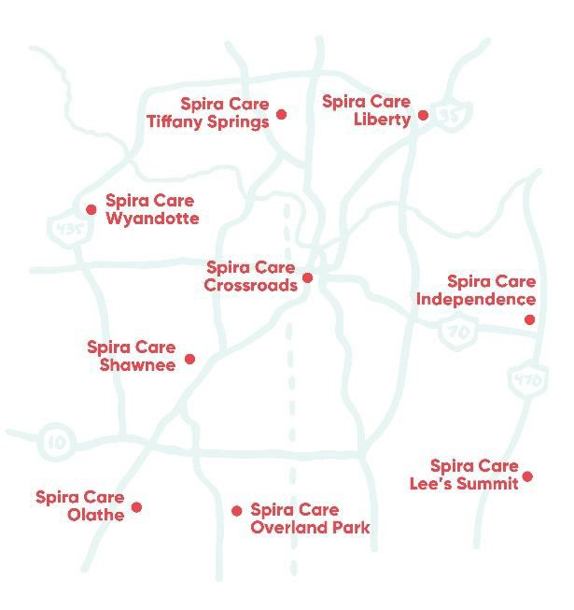
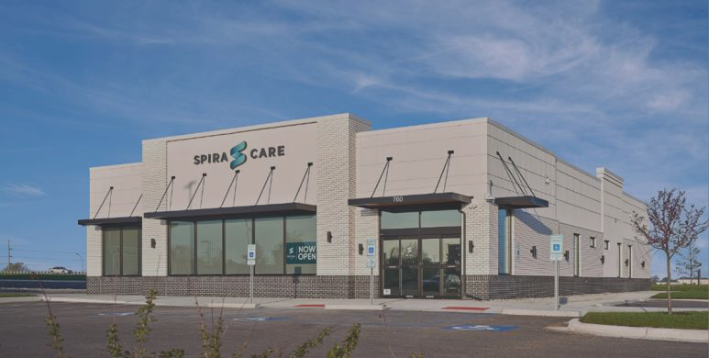

THERE IS A SPIRA CARE CENTER JUST AROUND THE CORNER
CROSSROADS
LIBERTY
SHAWNEE
INDEPENDENCE
OLATHE
TIFFANY SPRINGS
LEE’S SUMMIT
OVERLAND PARK
WYANDOTTE
Take a Virtual Tour at SpiraCare.com/TOUR

Slide 7



SPIRA CARE CENTERS & BLUESELECT PLUS NETWORK
SPIRA CARE CENTERS
Nine Spira Care Centers across the Kansas City metro area.
BLUESELECT PLUS NETWORK
NATIONAL BLUECARD
Access the BlueSelect Plus network for specialty care and hospitalizations.
BlueCard provides in- network access to medical care, nationally and internationally
12 Hospital Systems
4,100+ Physicians & Specialists 11,000 Access Points
Hospitals in the BlueSelect Plus Network
AdventHealth
Cameron Regional Medical Center
Children’s Mercy
Liberty Hospital
North Kansas City Hospital
Olathe Medical Center
Providence Medical Center
St. Joseph Medical Center
St. Mary's Medical Center University Health
(formerly Truman Medical)
University of Kansas Hospital
Western Missouri Medical Center
All other hospitals in the area are considered out-of-network.
Members pay until out-of-pocket maximum is met.

Slide 8

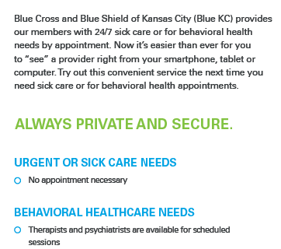
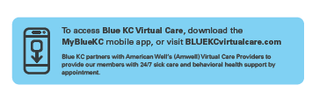


Slide 9

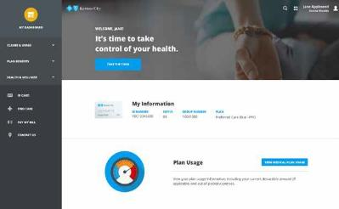


Your Member Portal: MyBlueKC.com
Desktop and Mobile
My Information
Quickly print/email your ID card
View Plan Benefits
View coverage & pharmacy info
Review Claims
View claims, EOB’s, deductible and Out of Pocket Max
Access to Wellness
A Healthier You
Find Care
Find doctors, hospitals, pharmacies, dental providers
Ask Us
Get answers to your questions
3
REGISTER!
You don’t even need your member ID card!

